Slide 1

MCA Major Project Mid Term Evaluation
Gaming Hub Web
Under the guidance of
Divya Sharma
Department of Computer Applications
Faculty of Science, Technology and Architecture
Manipal University Jaipur
By
Harsh Negi
Reg No. 23FS20MCA00083
2023-25

Slide 2
Outline
Introduction
Motivation
Process Model
Software Requirement Specification (SRS)
Data Flow Diagram (DFD)
Output
Conclusion
Future Scope

Slide 3
INTRODUCTION
🎮 Your Ultimate Destination for Gaming
What is Gaming Hub Website A one-stop platform for gamers, offering the latest news, game reviews, community forums, and exclusive content.
Why Choose Us? ✅ Stay updated with trending games ✅ Connect with a vibrant gaming community ✅ Access expert tips, tricks, and walkthroughs ✅ Enjoy seamless gaming experiences with our curated recommendations
Join the Adventure! Whether you're a casual player or a hardcore gamer, Gaming Hub Name website is the place for you! 🚀💥

Slide 4
MOTIVATION
Why We Created This Platform? 🎮🚀
Passion for Gaming We believe gaming is more than just entertainment—it's a way to connect, compete, and create unforgettable experiences.
Bridging the Community A dedicated space for gamers to interact, share insights, and grow together.
Access to the Best Content From game reviews to expert guides, we provide everything a gamer needs in one place.
Empowering Gamers Helping players of all skill levels enhance their gaming experience through knowledge, strategy, and community support.
Join us on this journey and level up your gaming world! 🎯🔥

Slide 5
PROCESS MODEL
How Our Gaming Hub Works 🎮⚙️
1️⃣ User Registration & Profile Setup
Sign up and create a personalized gaming profile.
Choose preferences to receive tailored content.
2️⃣ Game Discovery & Content Access
Explore trending games, reviews, and latest news.
Access walkthroughs, tips, and exclusive content.
3️⃣ Community Engagement
Join forums, discussions, and multiplayer events.
Connect with fellow gamers and share experiences.
4️⃣ Personalized Recommendations
AI-driven suggestions based on gaming interests.
Curated content to enhance user experience.
5️⃣ Rewards & Gamification
Earn points, achievements, and badges for participation.
Unlock exclusive perks and community rewards.
6️⃣ Continuous Updates & Support
Regular content updates and game patches.
24/7 customer support and community moderation.

Slide 6
SYSTEM REQUIREMENT SPECIFICATION
1. Introduction 🎮
Purpose: To define the functional and non-functional requirements of the Gaming Hub.
Scope: A platform providing gaming news, reviews, community engagement, and personalized recommendations.
Audience: Developers, stakeholders, and end-users.
2. Functional Requirements ⚙️
✅ User Registration & Authentication – Secure sign-up, login, and profile management. ✅ Game Catalog & Reviews – Browse and rate games, read expert and user reviews. ✅ Community Forum & Chat – Engage with other gamers, share experiences, and participate in discussions. ✅ Personalized Recommendations – AI-based game suggestions based on user preferences. ✅ Leaderboard & Achievements – Track progress, earn rewards, and compete with others.
3. Non-Functional Requirements 🔧
🔹 Scalability – Supports a growing number of users without performance issues. 🔹 Security – Ensures data protection, encrypted transactions, and user privacy. 🔹 Performance – Fast loading times and responsive design. 🔹 Availability – 99.9% uptime to ensure uninterrupted service.

Slide 7
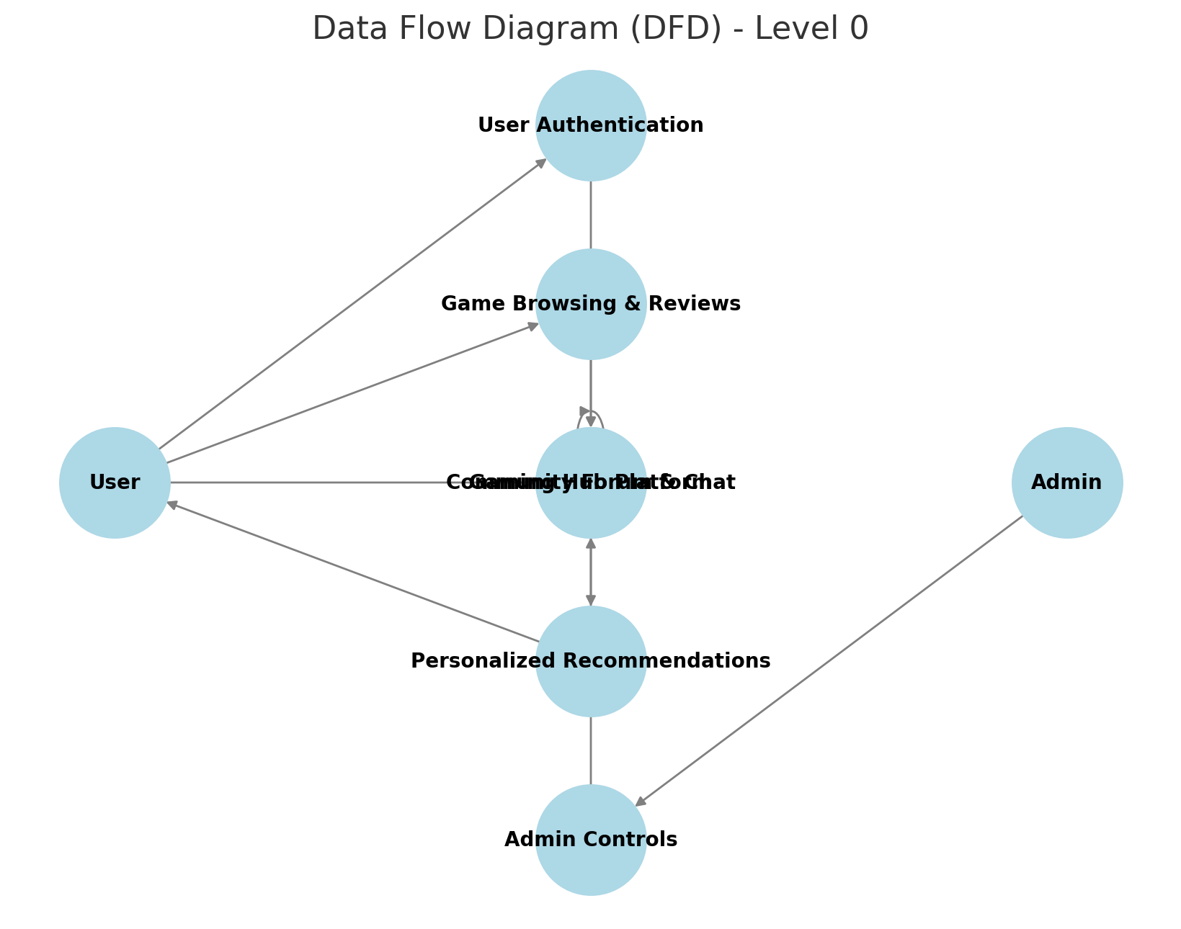
DFD

Slide 8
OUTPUT
The output of the Gaming Hub Website includes:
✅ Homepage – Displays trending games, latest news, and user recommendations. ✅ User Dashboard – Personalized game suggestions, achievements, and profile details. ✅ Game Reviews & Ratings – User and expert reviews with rating systems. ✅ Community Forum – Discussion boards, chat rooms, and multiplayer event updates. ✅ Leaderboards & Rewards – Tracks user rankings and achievements.
Would you like a UI mockup or a live preview design? 😊🎮

Slide 9
CONCLUSION
The Gaming Hub Website serves as an all-in-one platform for gamers, offering:
✔️ Seamless game discovery with personalized recommendations. ✔️ Community engagement through forums and multiplayer interactions. ✔️ Game reviews and expert insights to enhance decision-making. ✔️ Achievements and rewards to keep users motivated.
With a user-friendly interface, real-time updates, and an engaging community, this platform enhances the overall gaming experience. Level up your gaming journey with us! 🎯🔥
Let me know if you need any refinements! 😊

Slide 10
FUTURE SCOPE
Future Scope of the Gaming Hub Website 🎮🚀
1️⃣ Enhanced AI & Machine Learning 🤖
Smarter game recommendations based on player behavior and preferences.
AI-driven chatbots for instant user support.
2️⃣ Virtual & Augmented Reality (VR/AR) Integration 🕶️
Immersive gaming experiences with VR.
AR features for real-world interactive gaming.
3️⃣ Cloud Gaming & Cross-Platform Support ☁️📱💻
Play high-end games without downloads using cloud technology.
Seamless gaming experience across PC, mobile, and consoles.
4️⃣ Esports & Competitive Gaming 🏆
Hosting global gaming tournaments with live streaming.
In-game challenges and leaderboards to boost competition.
5️⃣ Blockchain & NFT Integration ⛓️
Secure in-game transactions using blockchain.
NFT-based digital assets and rewards for players.

Slide 11
THANK YOU

